Slide 1
Use Case Diagram

Slide 2
Use Case Diagram
The purpose of a use case diagram in UML is to demonstrate the different ways that a user might interact with a system.
A use case represents a function that the system performs.
Alternatively, a use case can be thought of as a goal that some actor can achieve with the system.
An actor association is an arrow connecting an actor to a use case. This arrow represents a conversation between the actor and the system component responsible for executing the use case.

Slide 3
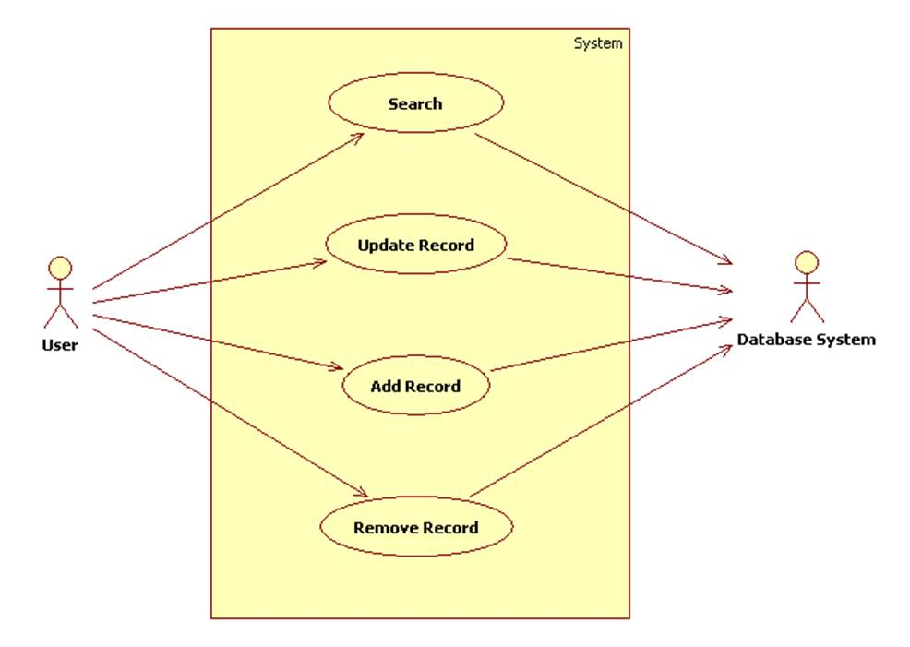
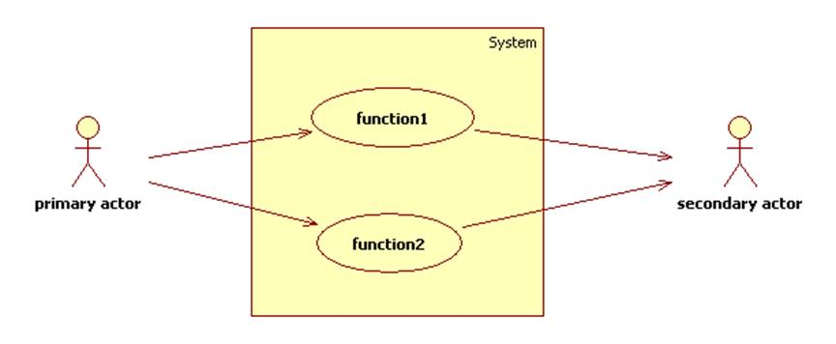
Use Case Diagram

Slide 4
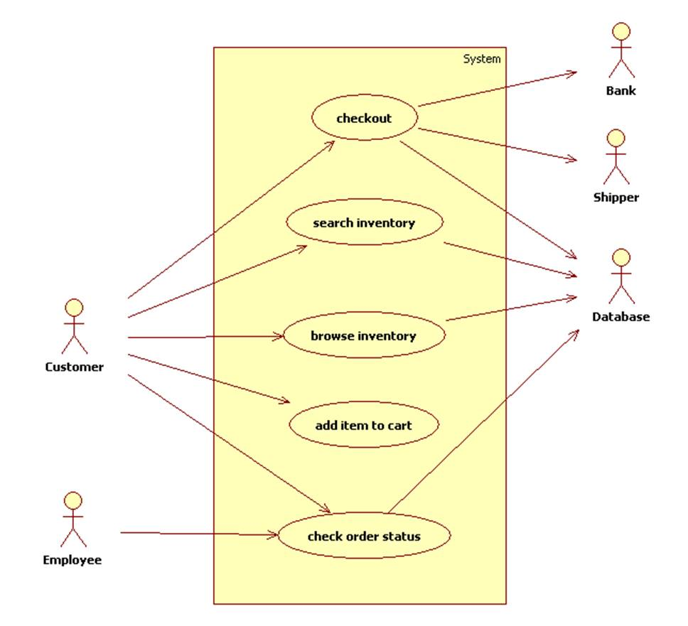
Notice that we do not attempt to show structures (like items or the cart) nor the flow of control (e.g., search items, add items, checkout, then check status) in a use case diagram.

Slide 5
What is a use case diagram?
In the Unified Modeling Language (UML), a use case diagram can summarize the details of your system's users (also known as actors) and their interactions with the system.
To build one, you'll use a set of specialized symbols and connectors.
An effective use case diagram can help your team discuss and represent:
Scenarios in which your system or application interacts with people, organizations, or external systems
Goals that your system or application helps those entities (known as actors) achieve
The scope of your system

Slide 6
When to apply use case diagrams
A use case diagram doesn't go into a lot of detail—for example, don't expect it to model the order in which steps are performed.
Instead, a proper use case diagram depicts a high-level overview of the relationship between use cases, actors, and systems.
Experts recommend that use case diagrams be used to supplement a more descriptive textual use case.

Slide 7
When to apply use case diagrams
UML is the modeling toolkit that you can use to build your diagrams.
Use cases are represented with a labeled oval shape.
Stick figures represent actors in the process, and the actor's participation in the system is modeled with a line between the actor and use case.
To depict the system boundary, draw a box around the use case itself.

Slide 8
When to apply use case diagrams
UML use case diagrams are ideal for:
Representing the goals of system-user interactions
Defining and organizing functional requirements in a system
Specifying the context and requirements of a system
Modeling the basic flow of events in a use case

Slide 9
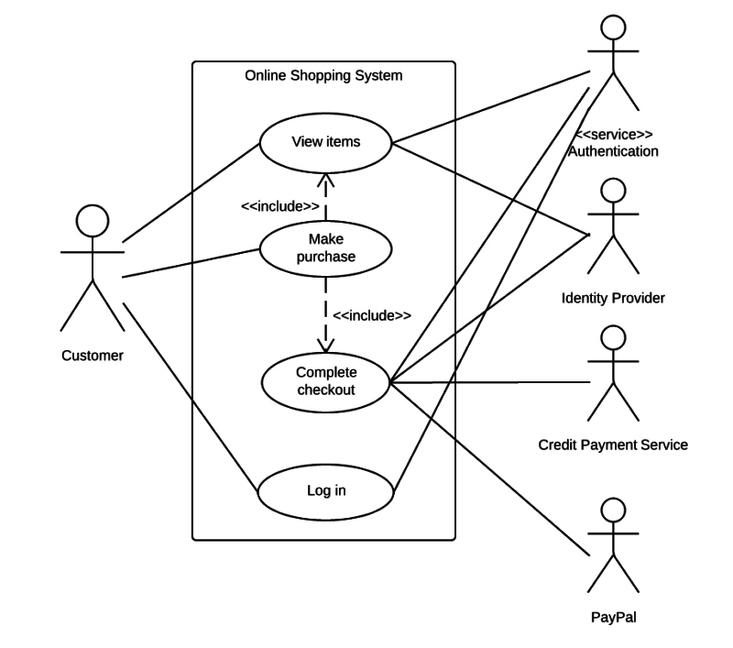

Slide 10
Use case diagram components
Actors: The users that interact with a system. An actor can be a person, an organization, or an outside system that interacts with your application or system. They must be external objects that produce or consume data.
System: A specific sequence of actions and interactions between actors and the system. A system may also be referred to as a scenario.
Goals: The end result of most use cases. A successful diagram should describe the activities and variants used to reach the goal.

Slide 11
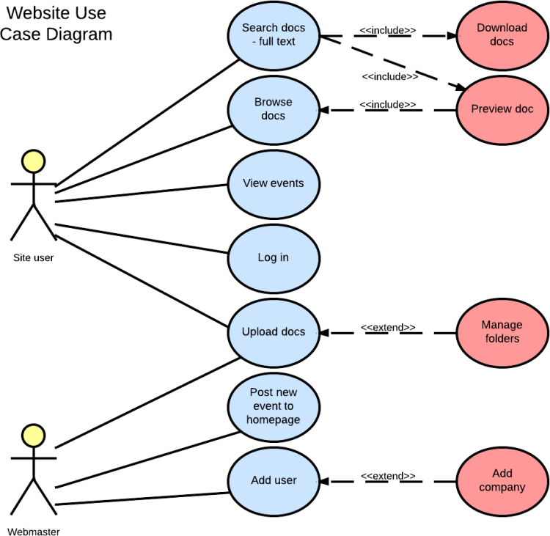

Slide 12
Use case diagram symbols and notation
Use cases: Horizontally shaped ovals that represent the different uses that a user might have.
Actors: Stick figures that represent the people actually employing the use cases.
Associations: A line between actors and use cases. In complex diagrams, it is important to know which actors are associated with which use cases.
System boundary boxes: A box that sets a system scope to use cases. All use cases outside the box would be considered outside the scope of that system.
Packages: A UML shape that allows you to put different elements into groups. Just as with component diagrams, these groupings are represented as file folders.

